Slide 1
Quantum Set Packing
A set packing problem solved with a quantum annealer

Slide 2
A brief overview over the quantum annealer
The quantum annealer used is accessible from this link. It is a controllable supercomputer that works at a temperature of approximately 12mK.
It aims to return a low-energy solution and it particularly fits optimization and sampling problems.
While the gate annealer requires problems to be expressed in terms of quantum gates, it requires them to be expressed in the language of operation research ones.

Slide 3
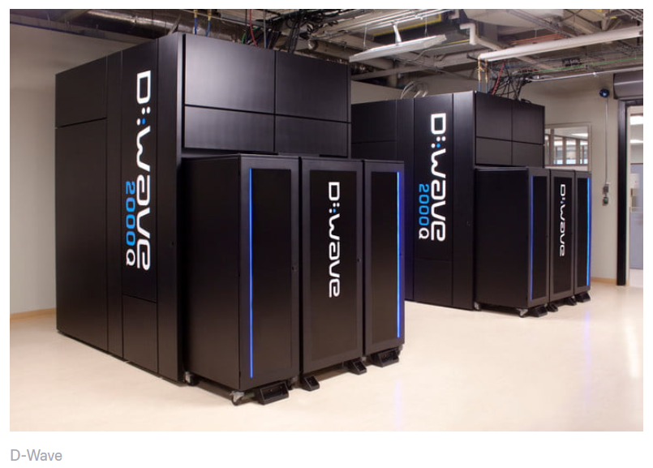
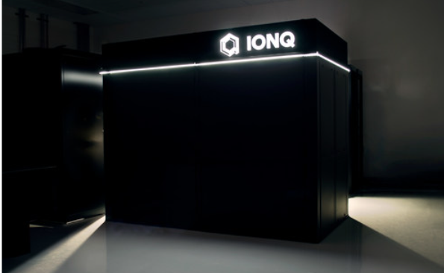
The set packing problem
While the gate quantum computer requires problems to be expressed in terms of quantum gates,
the annealer requires them to be expressed in the language of operation research ones.

Slide 4
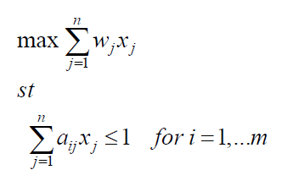
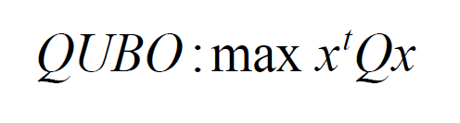

The set packing problem: Glover formalization
The Set Packing problem is a well-known optimization
Problem.
Goal: finding the best set of variables that satisfy
The objective function fitting each constraint
$w_{J}$ = weights. They represent the importance given
to each variable
$a_{i,J}$ = 1 if the corresponding variable has been chosen, 0 otherwise
One of the most famous problem classifiable as set packing problem
is the Facility Location Problem
Glover: the Set packing Problem
Glover: QUBO formulation

Slide 5
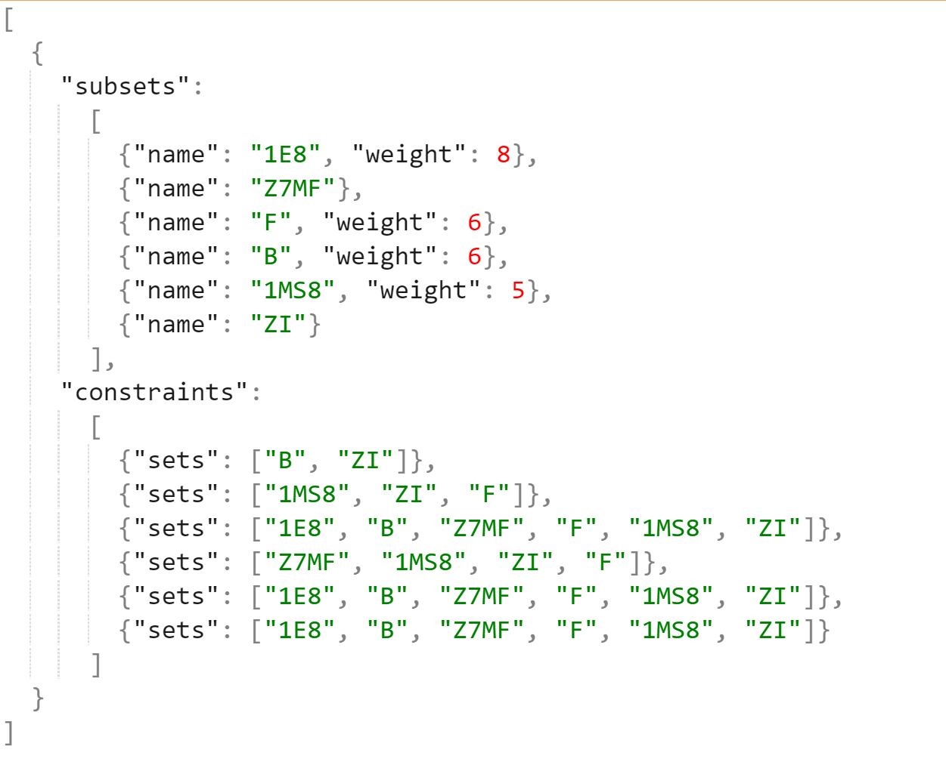
The problem generator
A generator of random set packing problems has been used to analyse different instances.
Since there was not an already existing format, a new one has been created and the chosen format is the Json one, since it is perfectly manageable using common python libraries.
Written in python,the problem generator allows creating randomly a proper instance of the set packing problem by writing it on an external file. This file, which is a .json file, is used by the algorithm to read data about the problems.
Thanks to this generator, It was possible to evaluate several instances of the problem with different variables/constraints, increasing the computational effort and thus testing each sampler’s performance.

Slide 6
The tools used: Advantage and 2000Q
2000Q
The D-Wave 2000Q system has a footprint of approximately 10' x 7' x 10' (L x W x H).
Its physical enclosure houses sophisticated cryogenic refrigeration, shielding, and I/O systems
to support a single thumbnail-sized QPU.
Most of the physical volume of the system is required to accommodate the refrigeration system
and to provide easy service access.
For quantum effects to play a role in computation, the QPU requires an extreme, isolated environment.
It works at a temperature of 15 mK and it has up to 2048 qubits and 6016 couplers.
ADVANTAGE
The Advantage™ system is the first and only quantum computer designed for business.
It is the 5th generation Advantage quantum computer that was built from the ground up with
a new processor architecture with over 5,000 qubits and 15-way qubit connectivity,
empowering enterprises to solve their largest and most complex business problems.
The main strength of the advantage Is the higher number of qubits, which makes it computationally more powerful
than the 2000Q while the main drawback is the high noise which affects its data.

Slide 7
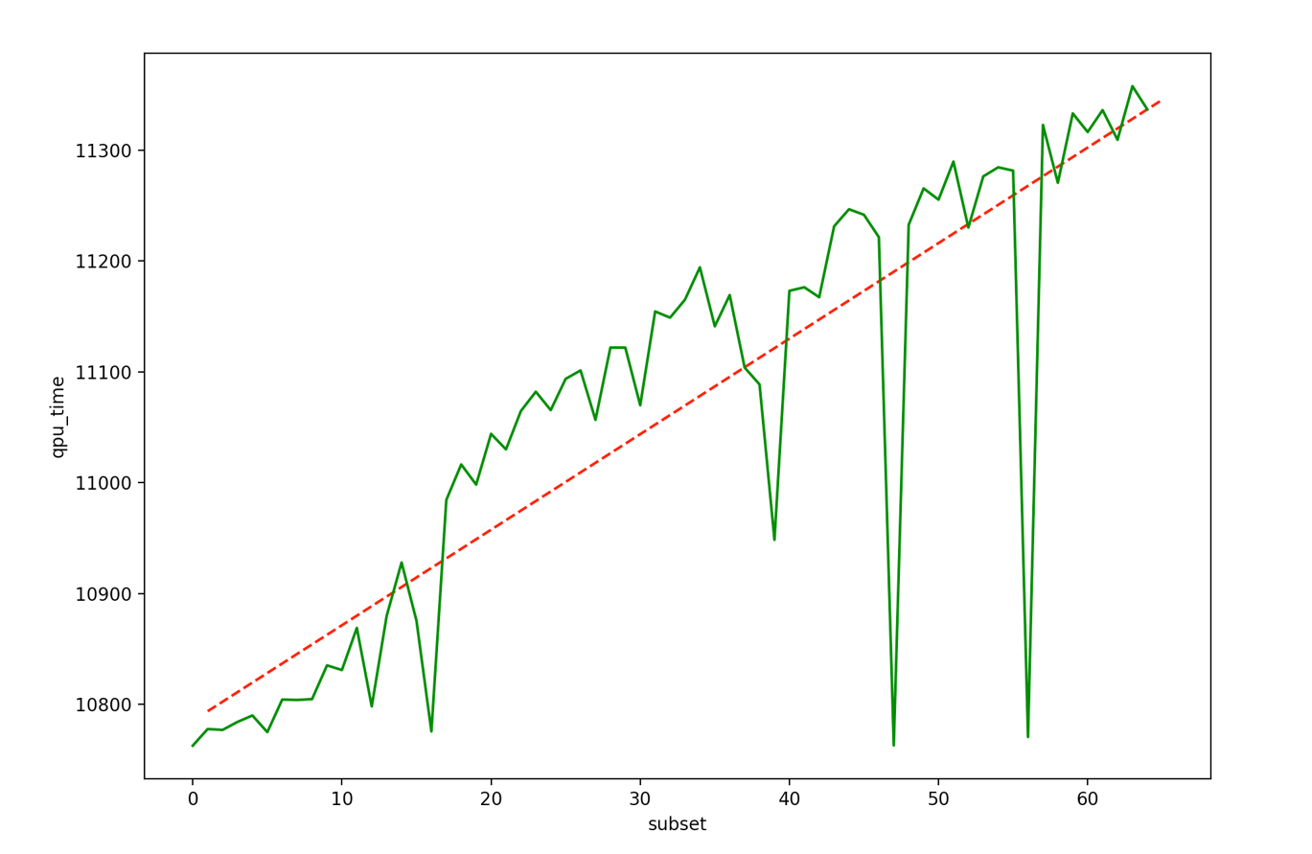
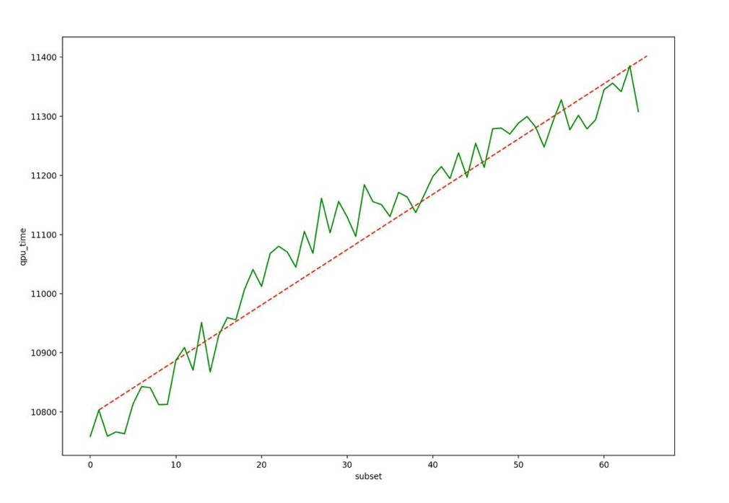
2000Q plot and results: time complexity
As it can be noticed, time increases concerning the number of subsets defined in the problem.
Occasional outliers in timing results are not unusual, because of noise from the operating system and runtime environment.
Here two different sequences of experiments are shown, the former presenting outliers, the latter with a more regular trend.
QPU time, in milliseconds, required to compute N subsets

Slide 8
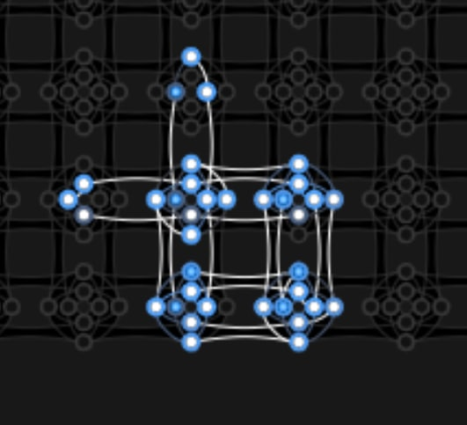
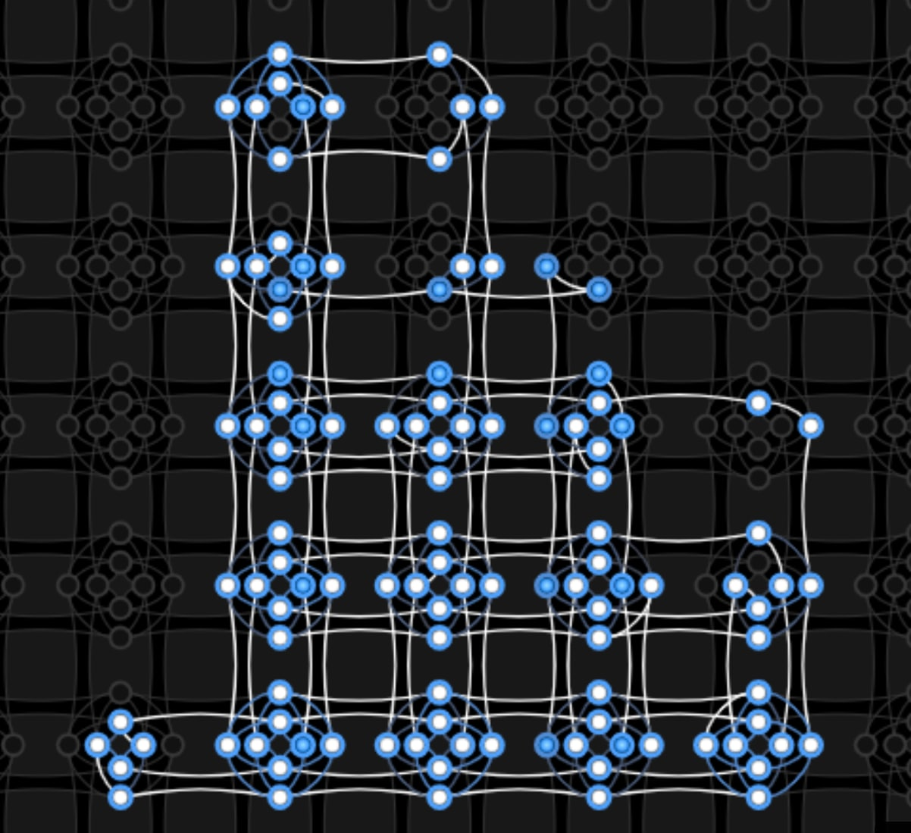
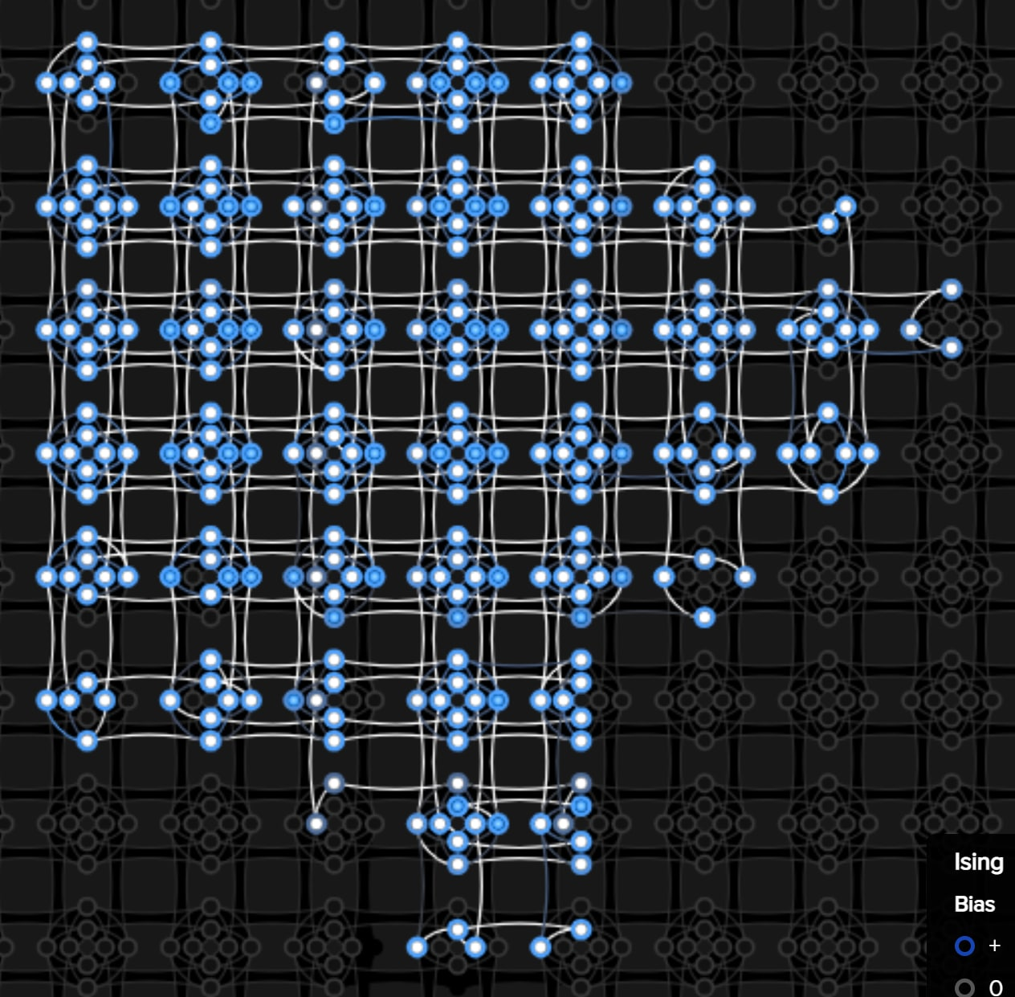
2000Q plot and results: spatial complexity
N = 10
Max chain length: 4
N = 20
Max chain length: 7
N = 30
Max chain length: 12

Slide 9
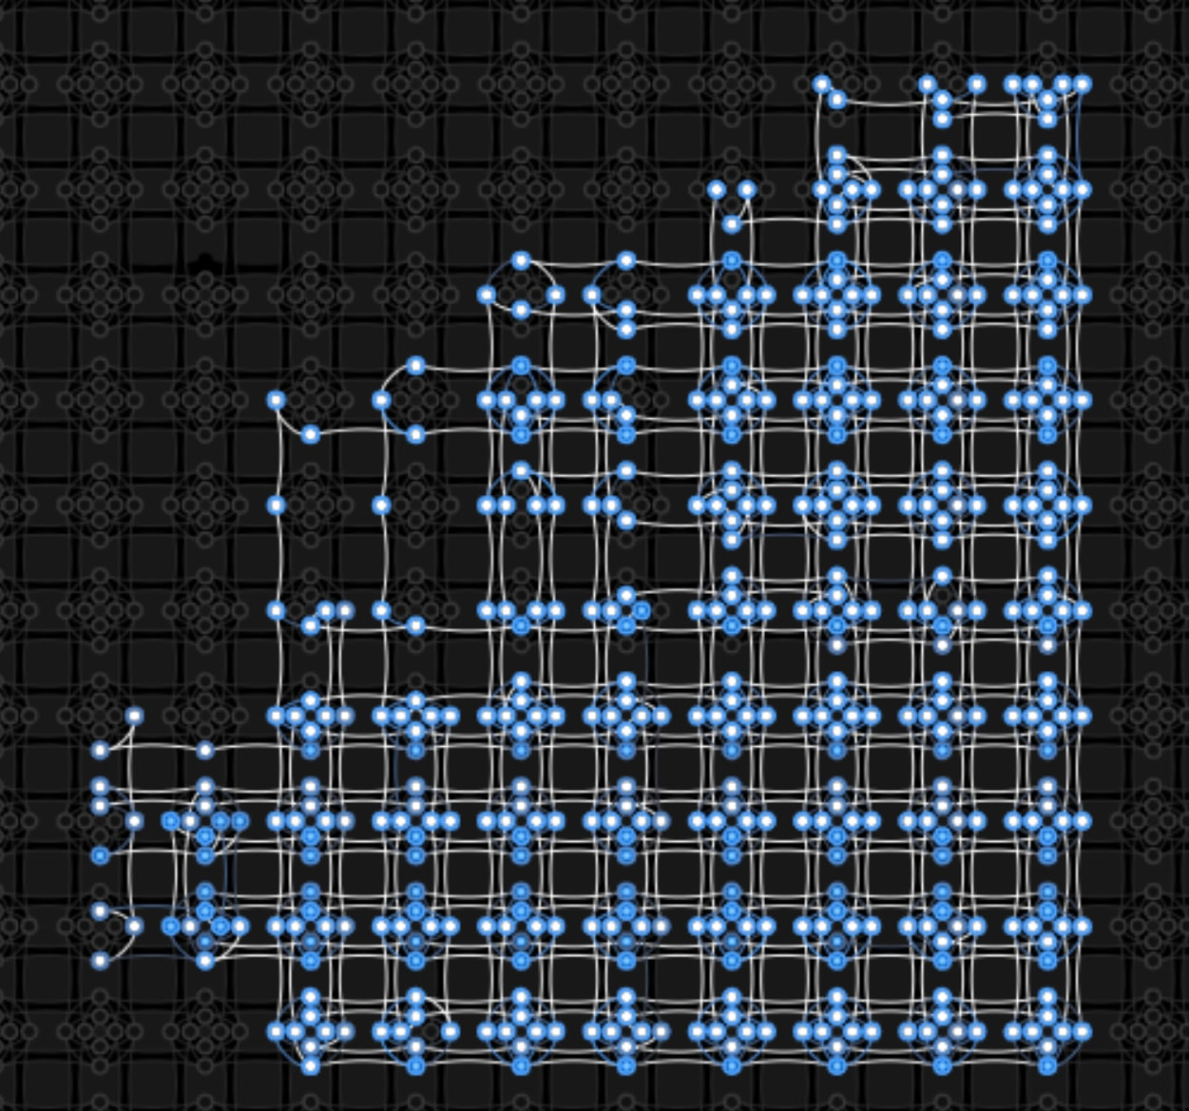
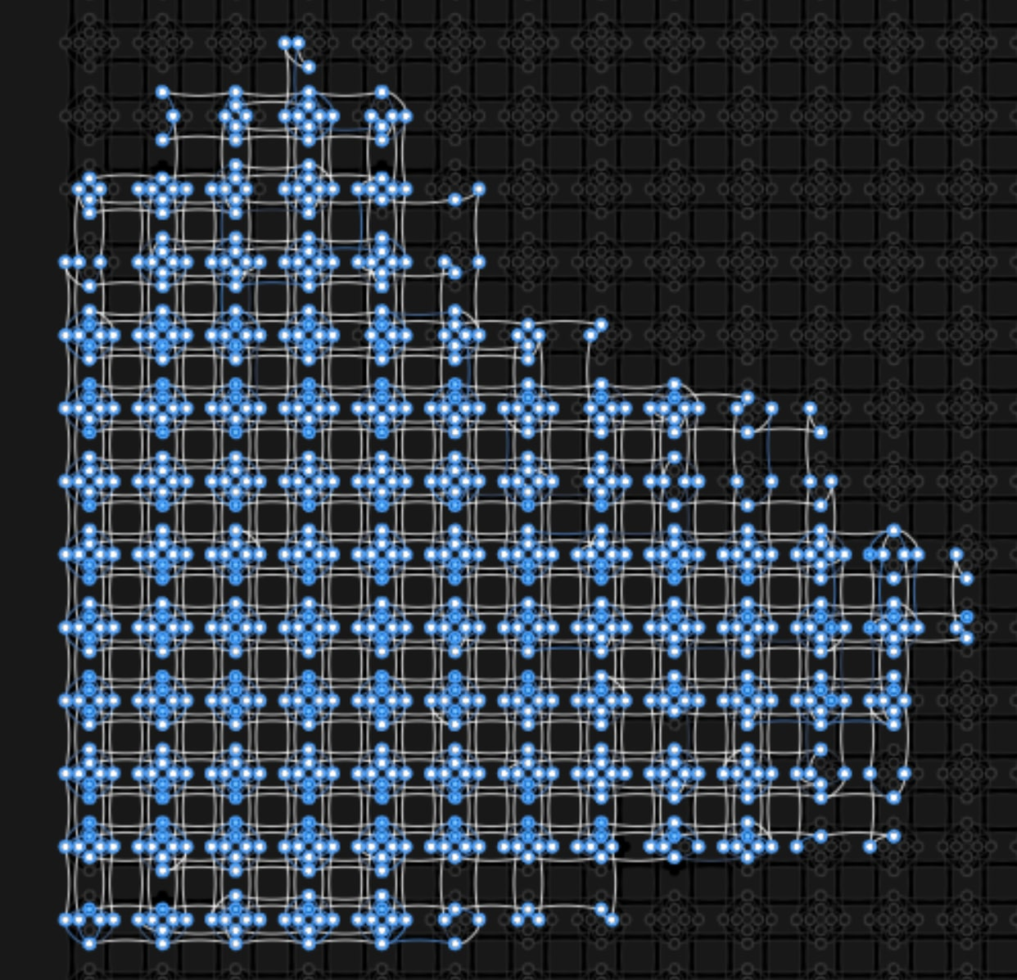
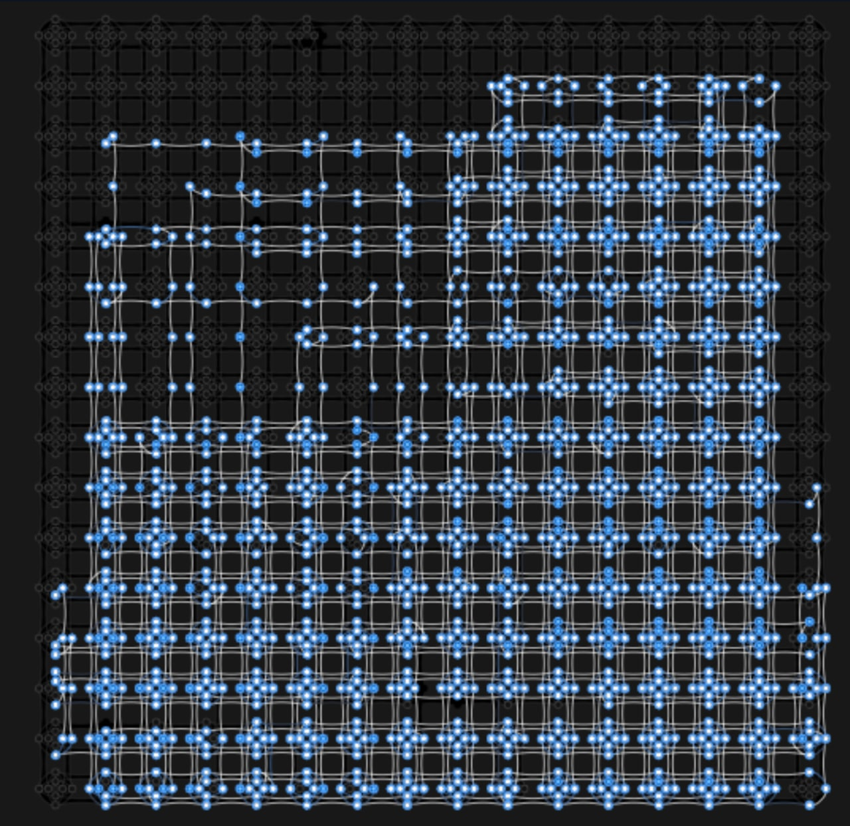
2000Q plot and results: spatial complexity
N = 40
Max chain length: 15
N = 50
Max chain length: 21
N = 60
Max chain length: 31

Slide 10
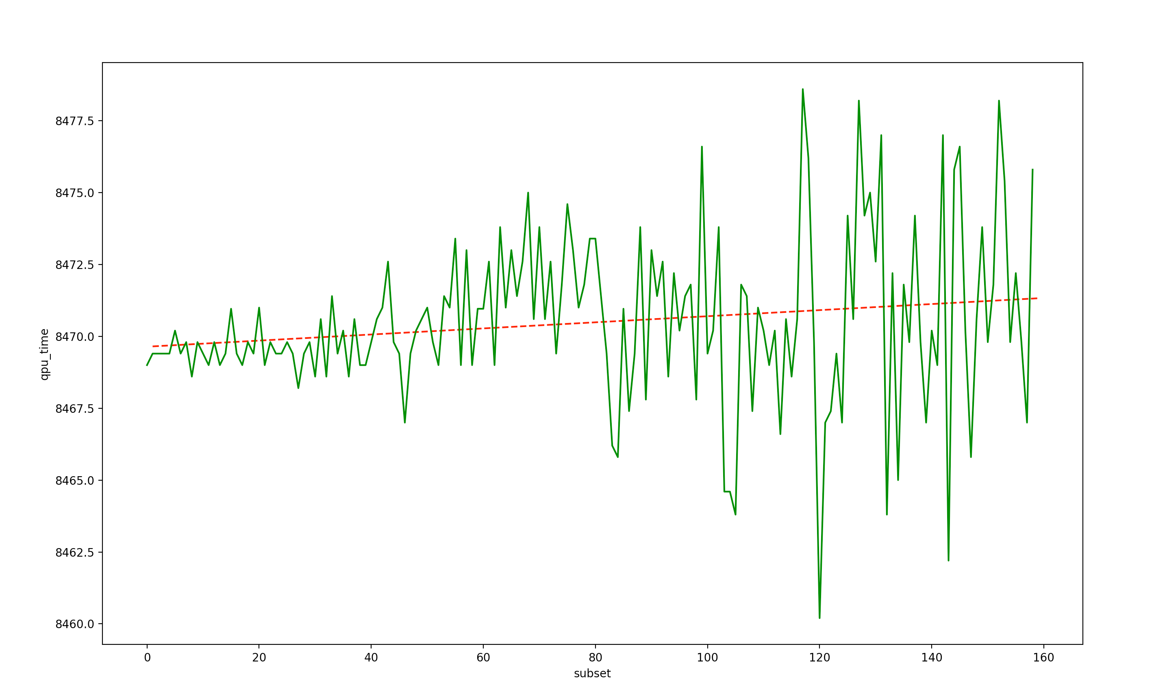
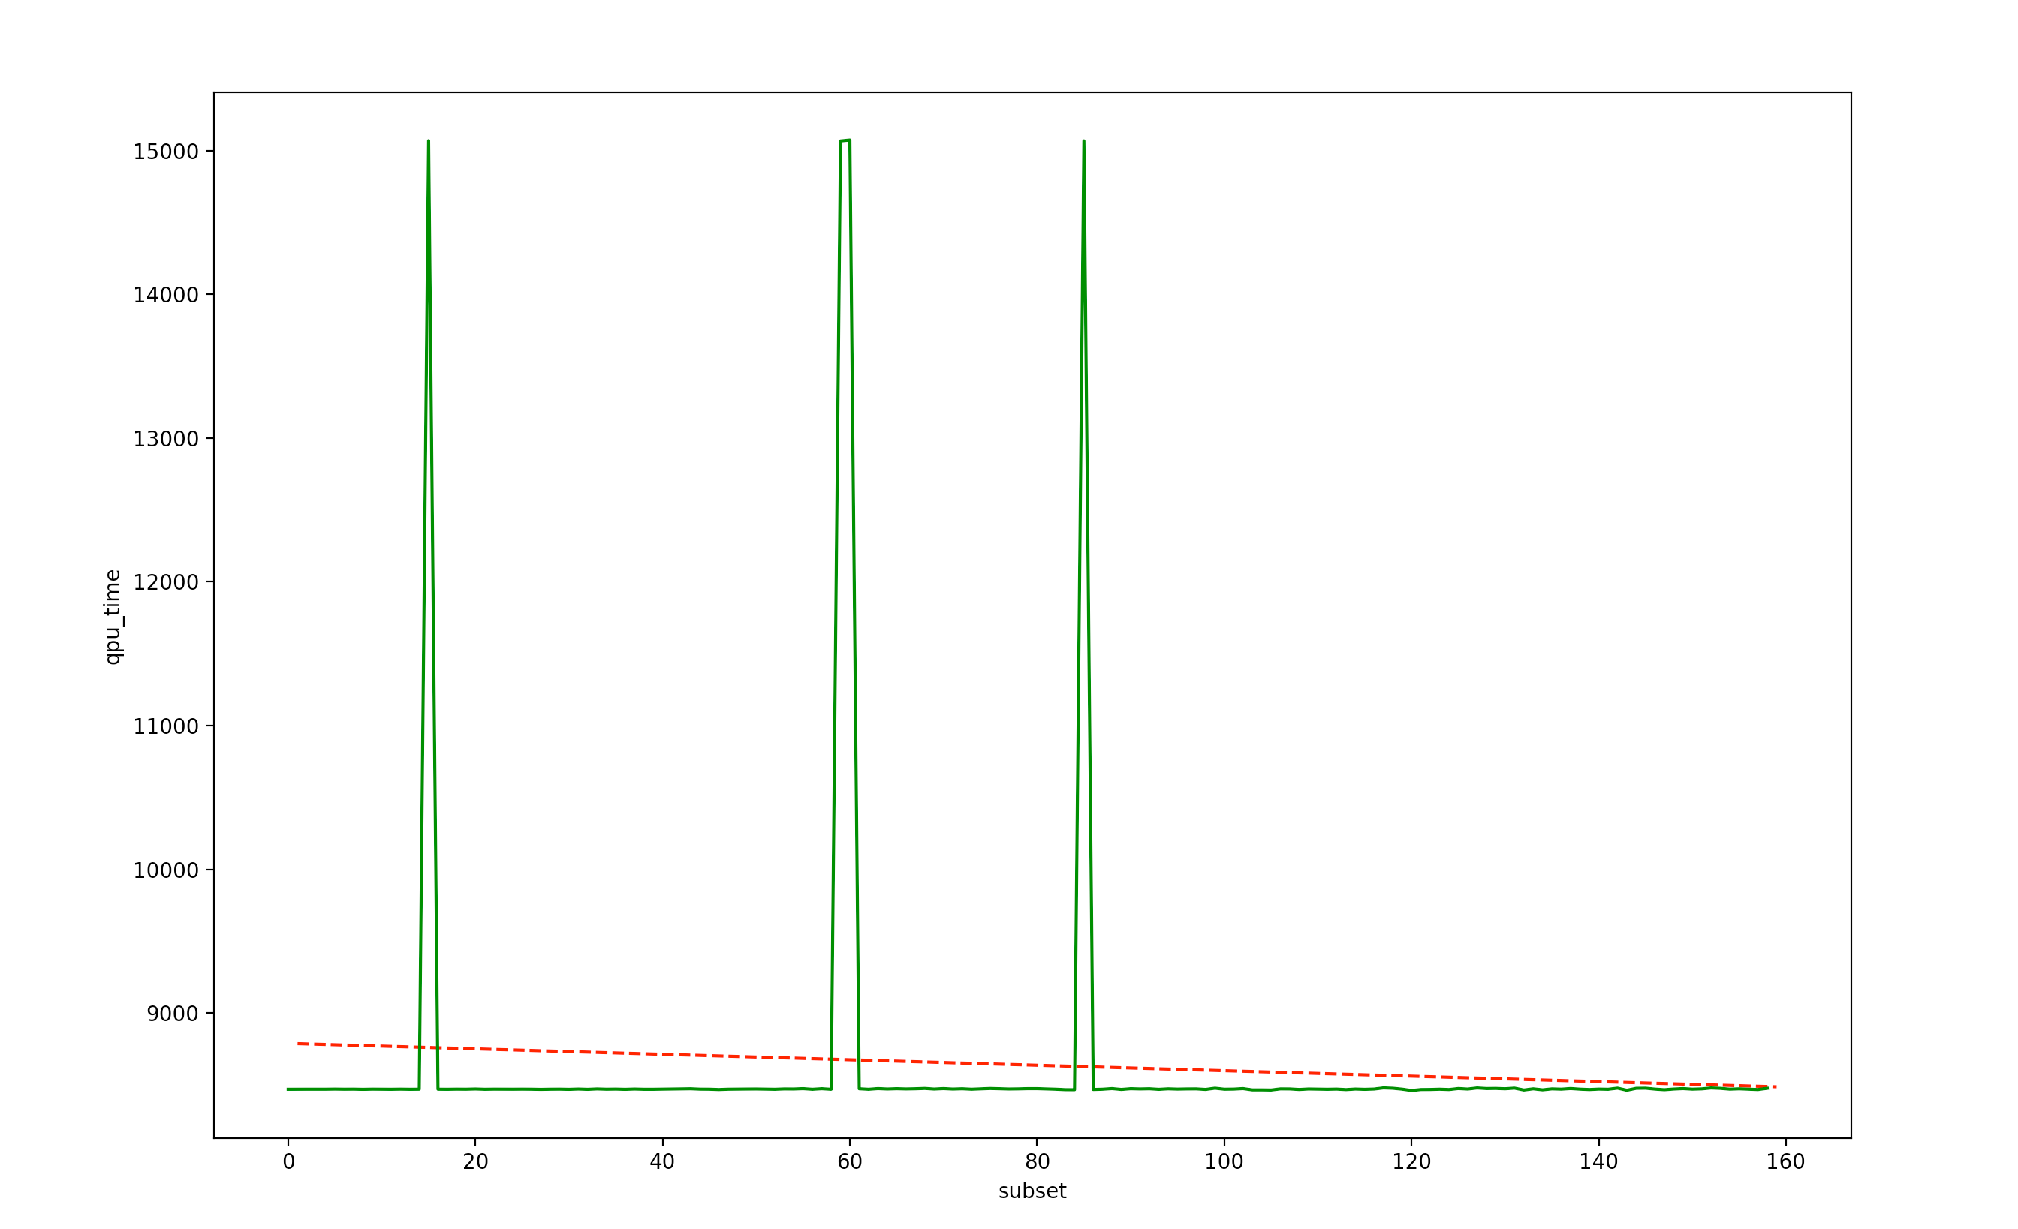
Advantage plot and results: time complexity
As it can be noticed, time increases concerning the number of subsets defined in the problem.
Also, in this case, there can be noticed several outliers.
The general trend is clearly less regular than the 2000Q timing, because of the presence of a greater amount of noise.
QPU time, in milliseconds, required to compute N subsets

Slide 11
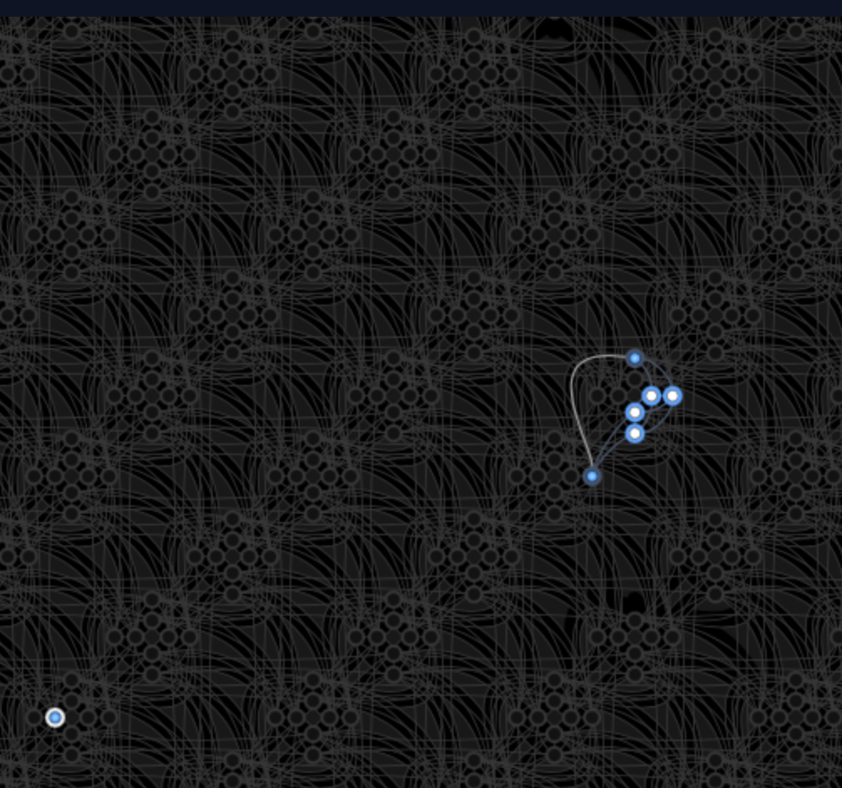
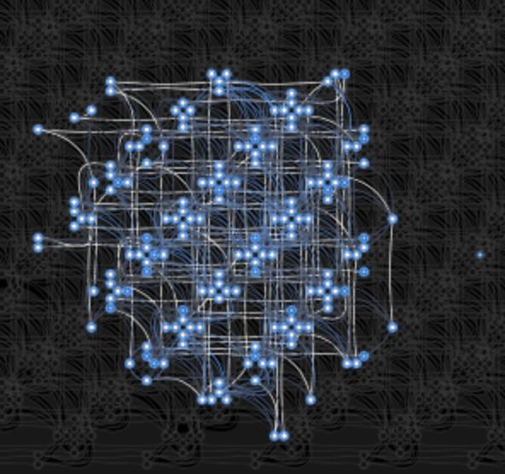
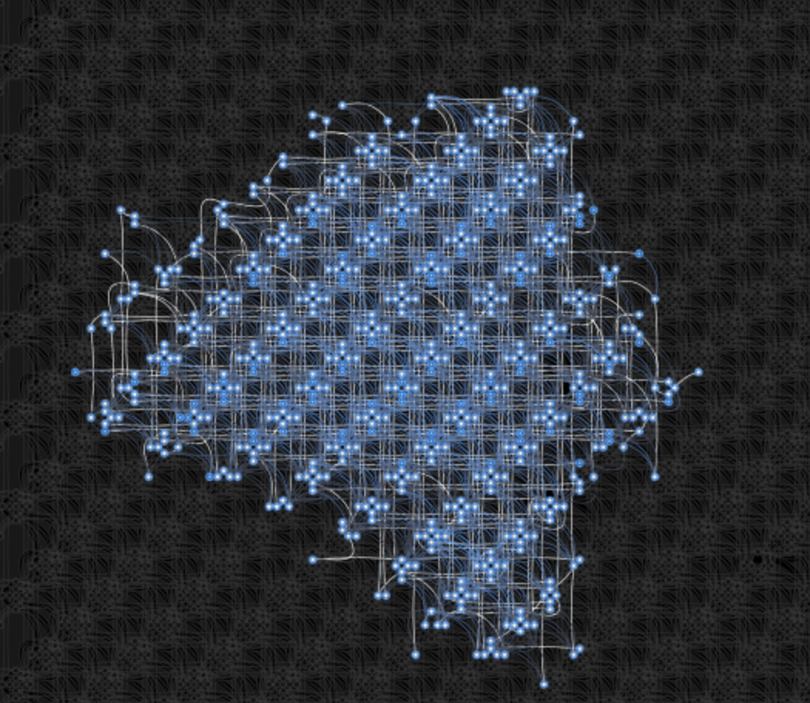
Advantage plot and results: space complexity
N = 10
Max chain length: 2
N = 40
Max chain length: 7
N = 70
Max chain length: 13

Slide 12
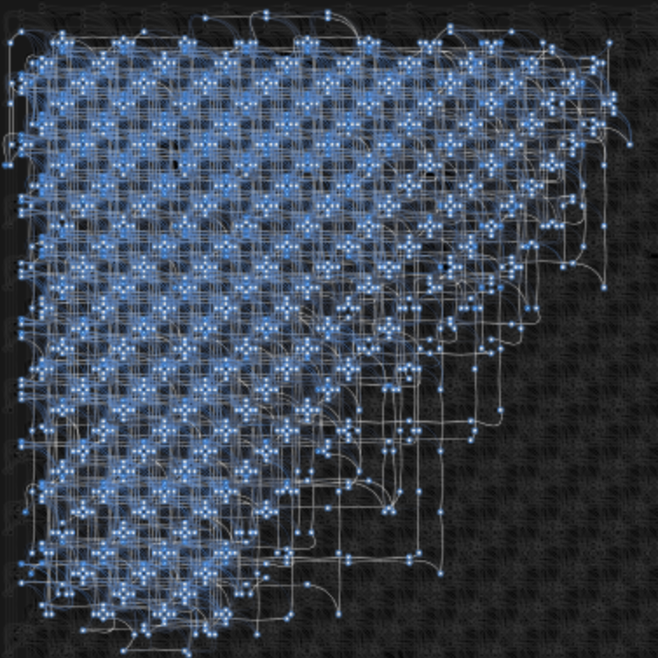
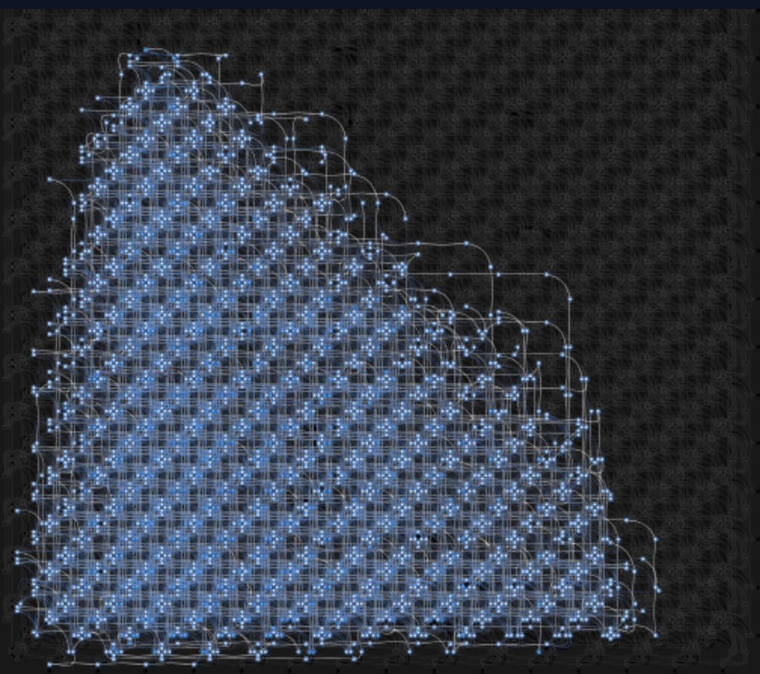
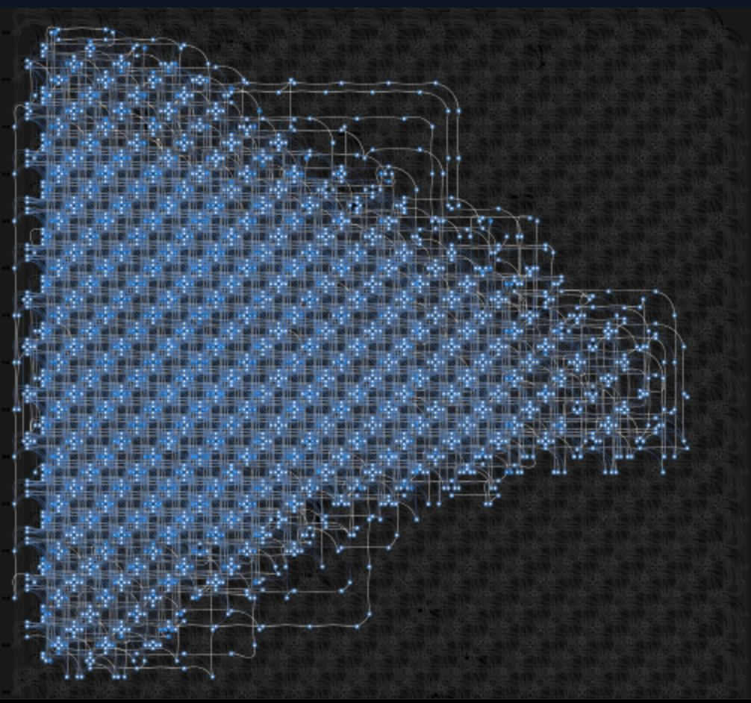
Advantage plot and results: space complexity
N = 100
Max chain length: 29
N = 130
Max chain length: 29
N = 150
Max chain length: 32

Slide 13
A brief comparison
Time Complexity
For what concerns time, Advantage results to be faster than 2000Q.
The increase in time duration results to be, in general, quite regular, even though some outlier spikes appear, as a response to noise.
Space Complexity
For what concerns space, because of the greater amount of qubits (5000 in the Advantage vs 2048 in the 2000Q), Advantage allows to solve problems with a higher value of the N parameter.
Additionally, a slightly higher maximum chain length has been noticed in the Advantage as well.

Slide 14
References
https://dwavejapan.com/app/uploads/2019/10/D-Wave-2000Q-Tech-Collateral_1029F.pdf
https://docs.dwavesys.com/docs/latest/c_qpu_annealing.html
https://docs.dwavesys.com/docs/latest/c_gs_2.html

